Slide 1
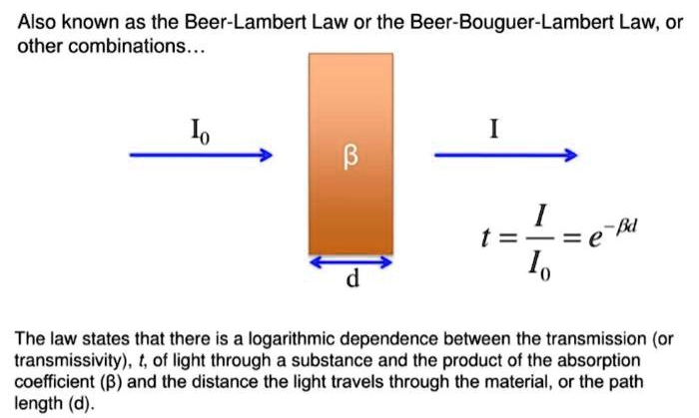
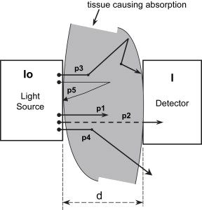
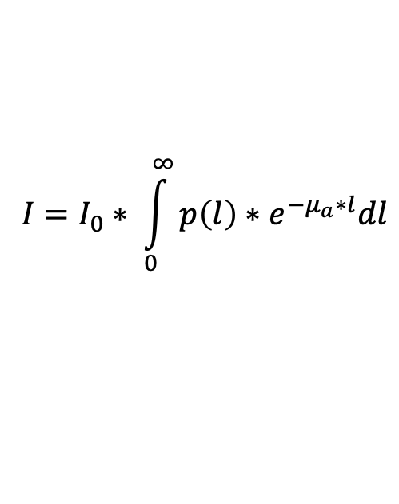

R is not enough plan
Beer Lambert Law
Modified Beer Lambert Law
$${I=I}_{0}∗ e^{−μ_{a}∗l}$$
$${I=I}_{0}∗ \int_{0}^{∞}{{p\left(l\right)∗e}^{−μ_{a}∗l}dl}$$
$$abs attenuation$$
$p\left(l\right)$ : Pathlength distribution of detected photons (no abs).
Angelo Sassaroli and Sergio Fantini 2004 Phys. Med. Biol. 49 N255

Slide 2
Multi-compartment MBLL
Location dependent
Neck & wrist
Arterial, venous, and muscle (tissue)
Forearm (vein only)
Venous and muscle (tissue)

Slide 3
The idea
Ultrasound of area
Monte Carlo Model
Compute mean photon pathlength
Pre-computed
Using Mean Photon Pathlength -> Expected I with MBLL equation
Optimize against collected sensor I
SvO2 value
Update guess
Levenberg–Marquardt algorithm
Sensor data detected I

Slide 4
3 cases at each location
AC - cardiac frequency
Both arterial and venous contributions
AC - respiration rate
Mostly venous contribution
DC
Non-pulsatile artery and vein
optimize against each other

Slide 5
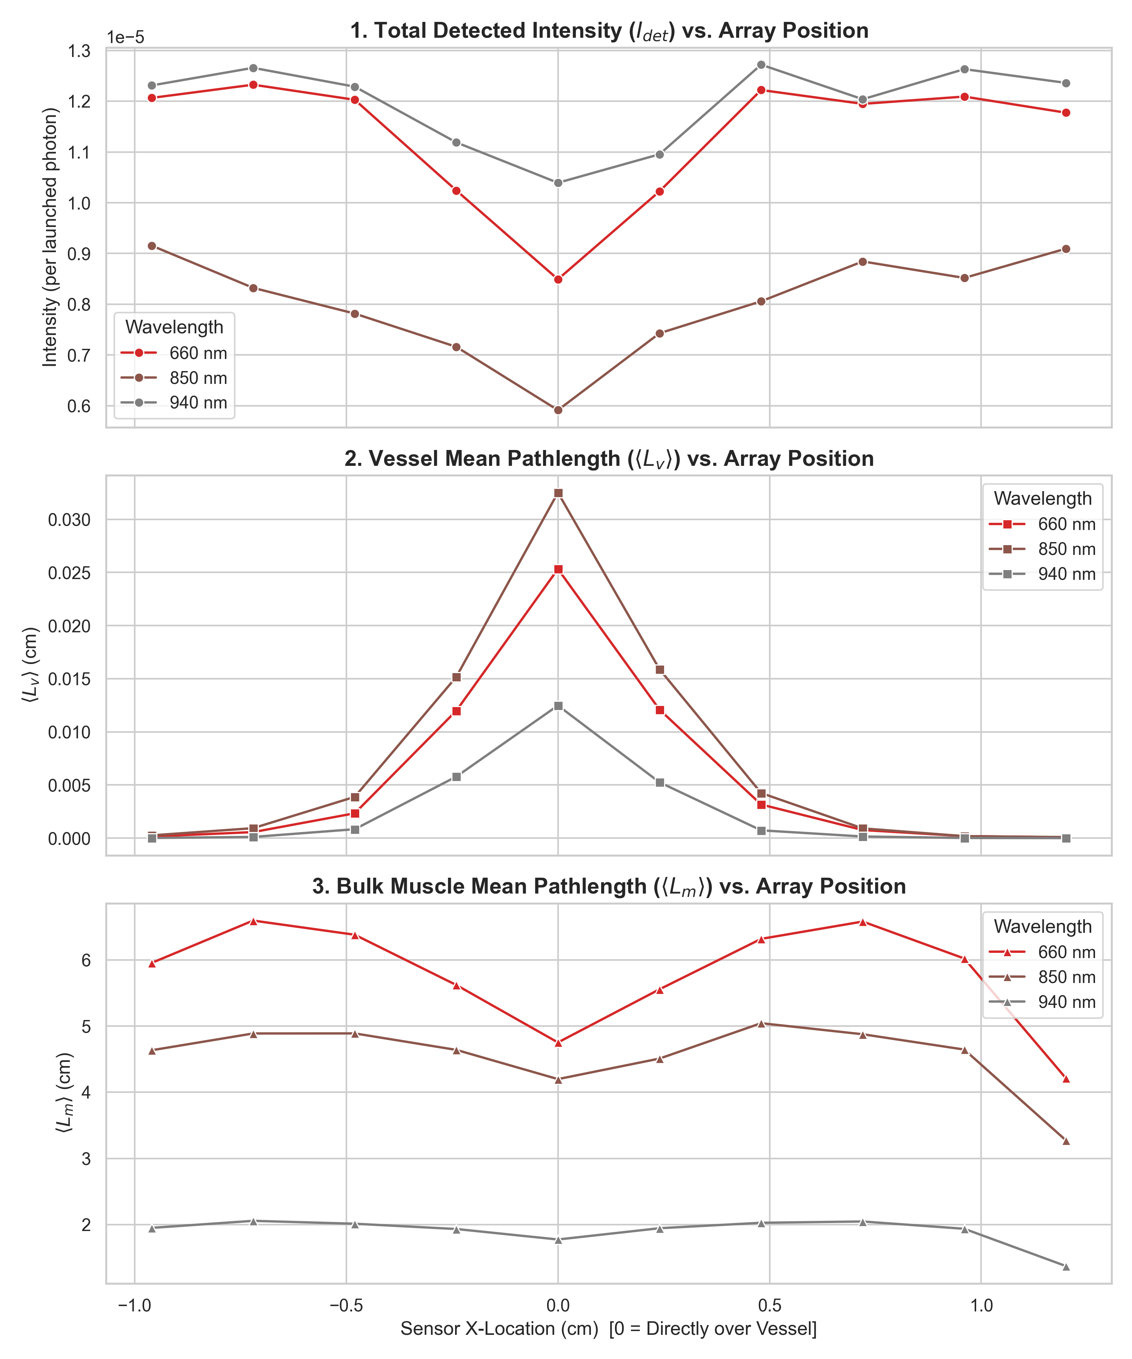
Simulation results so far
0.0 mm
-2.4 mm

